Slide 1
Chapter 1
Introduction
Introduction
1-<number>

Slide 2
Chapter 1: Introduction
Our goal:
get “feel” and terminology
more depth, detail later in course
approach:
  use Internet as example
Overview:
What is the Internet?
network edge
network core
access net, physical media
Internet/ISP structure
protocol layers, service models
Introduction
1-<number>

Slide 3
Chapter 1: roadmap
  What is the Internet?
  Network edge
  Network core
  Network access and physical media
  Internet structure and ISPs
  Protocol layers, service models
Introduction
1-<number>

Slide 4




What is the Internet?: “nuts and bolts” view
hosts = end systems
  running network apps
communication links
  fiber, copper, radio, satellite
  transmission rate = bandwidth
routers: forward packets (chunks of data)
protocols control sending, receiving of msgs
  e.g., TCP, IP, HTTP, FTP, PPP
Internet standards
  IETF: Internet Engineering Task Force
    RFC: Request for comments
  IEEE: Institute of Electrical and Electronics
router
workstation
company
network
server
mobile
regional ISP
company
network
Introduction
1-<number>

Slide 5
What’s the Internet?: a service view
Communication services provided to apps:
  Connectionless services
  connection-oriented services
Introduction
1-<number>

Slide 6
Network edge: connection-oriented service
Goal: data transfer between end systems
handshaking: setup (prepare for) data transfer ahead of time
  Hello, hello back human protocol
  set up “state” in two communicating hosts
TCP - Transmission Control Protocol
  Internet’s connection-oriented service
TCP service [RFC 793]
reliable, in-order byte-stream data transfer:
  loss: acknowledgements and retransmissions
flow control:
  sender won’t overwhelm receiver
congestion control:
  senders “slow down sending rate” when network congested
Introduction
1-<number>

Slide 7
Network edge: connectionless service
Goal: data transfer between end systems
  same as before!
UDP - User Datagram Protocol [RFC 768]:
  connectionless
  unreliable data transfer
  no flow control
  no congestion control
App’s using UDP:
streaming media, teleconferencing, DNS, Internet telephony
Introduction
1-<number>

Slide 8
The Network Core
mesh of interconnected routers
the fundamental question: how is data transferred through net?
  circuit switching: dedicated circuit per call: telephone net
  packet-switching: data sent thru net in discrete “chunks”
Introduction
1-<number>

Slide 9
Network Core: Circuit Switching
End-End resources reserved
link bandwidth, switch capacity
dedicated resources: no sharing
circuit-like (guaranteed) performance
call setup required
Introduction
1-<number>

Slide 10
Network Core: Packet Switching
resource contention:
  aggregate resource demand can exceed amount available
congestion:
  packets queue, wait for link use
store and forward:
  Node receives complete packet before forwarding
  packets move one hop at a time
Introduction
1-<number>

Slide 11
Example-1
Consider an application that transmits data at a steady rate (for example, the sender generates an N-bit unit of data every k time units, where k is small and fixed). Also, when such an application starts, it will continue running for a relatively long period of time. Answer the following questions, briefly justifying your answer:
  Would a packet-switched network or a circuit-switched network be more appropriate for this application? Why?
  Suppose that a packet-switched network is used and the only traffic in this network comes from such applications as described above. Furthermore, assume that the sum of the application data rates is less than the capacities of each and every link. Is some form of congestion control needed? Why?
Introduction
1-<number>

Slide 12
Example-2
Suppose users share a 3 Mbps link. Also suppose each user requires 150 kbps when transmitting, but each user transmits only 10 percent of the time.
When circuit switching is used, how many users can be supported?
For the remainder of this problem, suppose packet switching is used. Find the probability that a given user is transmitting.
Suppose there are 120 users. Find the probability that at any given time, exactly n users are transmitting simultaneously.
Introduction
1-<number>

Slide 13
Four sources of packet delay in Packet-switching
1. nodal processing:
  check bit errors
  determine output link
2. queueing
  time waiting at output link for transmission
  depends on congestion level of router
transmission
A
propagation
B
nodal
processing
C
queueing
Introduction
1-<number>

Slide 14
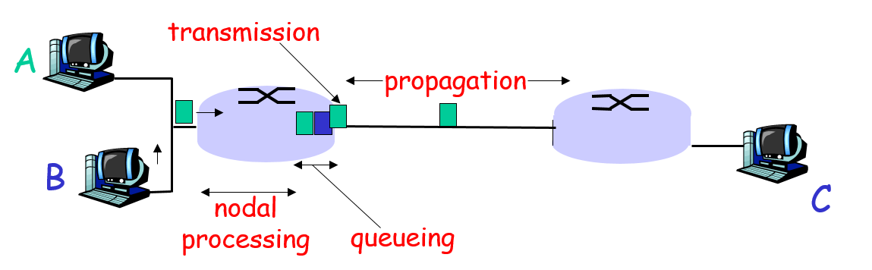
Delay in packet-switched networks
3. Transmission delay:
R= link bandwidth (bps)
L= packet length (bits)
Transmission time to send bits into link = L/R
Introduction
1-<number>

Slide 15
Delay in packet-switched networks
4. Propagation delay:
d = length of physical link
s = propagation speed in
medium (~2x10⁸ m/sec)
Propagation delay = d/s
Introduction
1-<number>

Slide 16
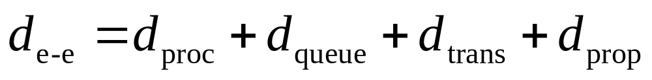
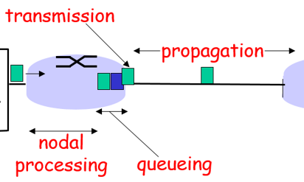
Delay in packet-switched nets (_{de – e} )
d_{proc} = processing delay
  typically a few microsecs or less
d_{queue} = queuing delay
  depends on congestion
d_{trans} = transmission delay
  = L/R, significant for low-speed links
d_{prop} = propagation delay
  a few microsecs to hundreds of msecs
Introduction
1-<number>

Slide 17





Example-3:
L bits
per packet
source
1
R bps
R bps
destination
A. What is the end-end delay of sending one packet of size L bits from source to destination over a path consisting of 2 links with each of link has a rate of R bps?
B. Generalize your answer for one packet of size L bits with N links with each of link has a rate of R bps?
  Account for the transmission delay only. Ignore the rest of delay components.
Introduction
1-<number>

Slide 18
Example-4:
L bits
per packet
source
3
2
1
R bps
R bps
destination
A. Let’s now consider sending 3 packets back-to-back from source to destination over a path consisting of 2 links each of rate R and the packet size is L bits. What is the end-end delay?
B. Let’s now consider the general case of sending P packets back-to-back from source to destination over a path consisting of N links each of rate R and the packet size is L bits. What is the end-end delay?
Applying the same logic as before, what is the end-end delay?
Introduction
1-<number>

Slide 19
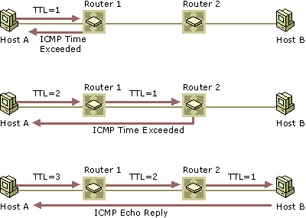
“Real” Internet delays and routes
Traceroute program on Windows Machine
Introduction
1-<number>

Slide 20
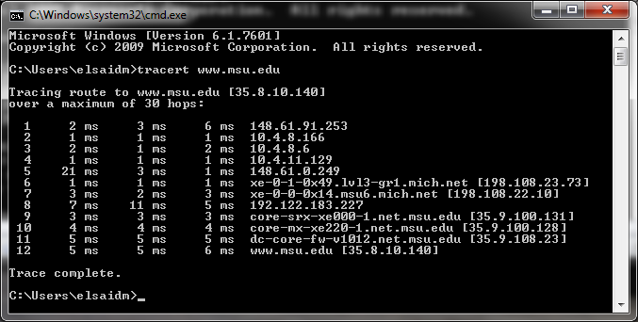

“Real” Internet delays and routes
Introduction
1-<number>

Slide 21
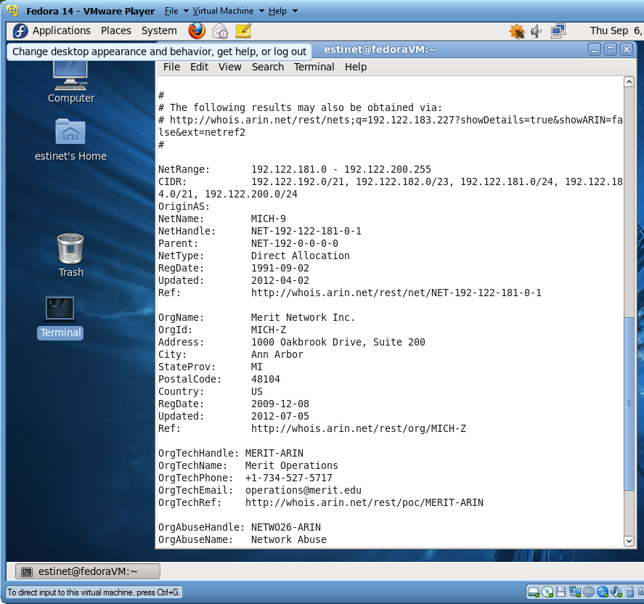
Introduction
1-<number>

Slide 22

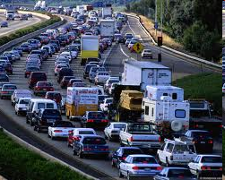
Queueing delay (revisited)
R: link bandwidth (bps)
L: packet length (bits)
a: average packet arrival rate to the input queue (pkts/sec)
average rate at which bits arrive to the queue = a(pks/sec) . L (bits/pkt) = al (bits/sec)
Traffic intensity= la (bits/sec) / R (bits/sec)
average queueing delay
traffic intensity
= La/R
If La/R > 1: → la > R
  avg. queueing delay large
If La/R < 1: → la < R
  “work”
La/R > 1
Introduction
1-<number>

Slide 23
Example-5
Consider the queuing delay in a router buffer (preceding an outbound link). Suppose all packets are L bits, the transmission rate is R bps and that N packets simultaneously arrive at the buffer. Assume the queuing delay per packet is equal to L/R.
  Find the average queuing delay of a packet.
Introduction
1-<number>

Slide 24
Example-6
In this problem, we consider sending voice from host A to host B over a packet switched network such as Internet phone. Host A converts an analog voice to a digital 64kbps bit stream on the fly. Host A then groups the bits into 48 byte packets.
There is one link between Host A and Host B; its transmission rate is 1Mbps and its propagation delay is 2 msec/km. The distance between host A and host B is 2km.
As soon as host A gather a packet, it sends it to host B. As soon as host B receives the entire packet, it converts the packet to analog signal.
  How much time elapses to generate, transmit and receive the first bit of the voice packet at host B?
Introduction
1-<number>

Slide 25
Packet loss
queue (aka buffer) preceding link in buffer has finite capacity
packet arriving to full queue dropped (aka lost)
lost packet may be retransmitted by previous node, by source end system, or not at all
buffer
(waiting area)
A
packet being transmitted
B
packet arriving to
full buffer is lost
Introduction
1-<number>

Slide 26
Throughput
throughput: rate (bits/time unit) at which bits transferred between sender/receiver
  average: rate over longer period of time
  instantaneous: rate at a given point in time
  average end-end: controlled by the link bit rate
server, with
file of F bits
to send to client
link capacity
R_{s} bits/sec
link capacity
R_{c} bits/sec
server sends bits
(fluid) into pipe at rate
R_{s} bits/sec
pipe that can carry
fluid at rate
R_{s} bits/sec)
pipe that can carry
fluid at rate
R_{c} bits/sec)
Introduction
1-<number>

Slide 27
Throughput (more)
R_{s} < R_{c} What is average end-end throughput?
#1
#2
R_{s} bits/sec
R_{c} bits/sec
R_{s} > R_{c} What is average end-end throughput?
#1
#2
R_{s} bits/sec
R_{c} bits/sec
bottleneck link
link on end-end path that constrains end-end throughput
e-e Throughput = min(Rc, Rs)
Introduction
1-<number>

Slide 28
Chapter 1: roadmap
  What is the Internet?
  Network edge
  Network core
  Network access and physical media
  Internet structure and ISPs
  Protocol layers, service models
Introduction
1-<number>

Slide 29

Access networks and physical media
ISP Network
Q: How to connect end systems to edge router?
  residential access nets
  institutional access networks (school, company)
Campus Network
Introduction
1-<number>

Slide 30
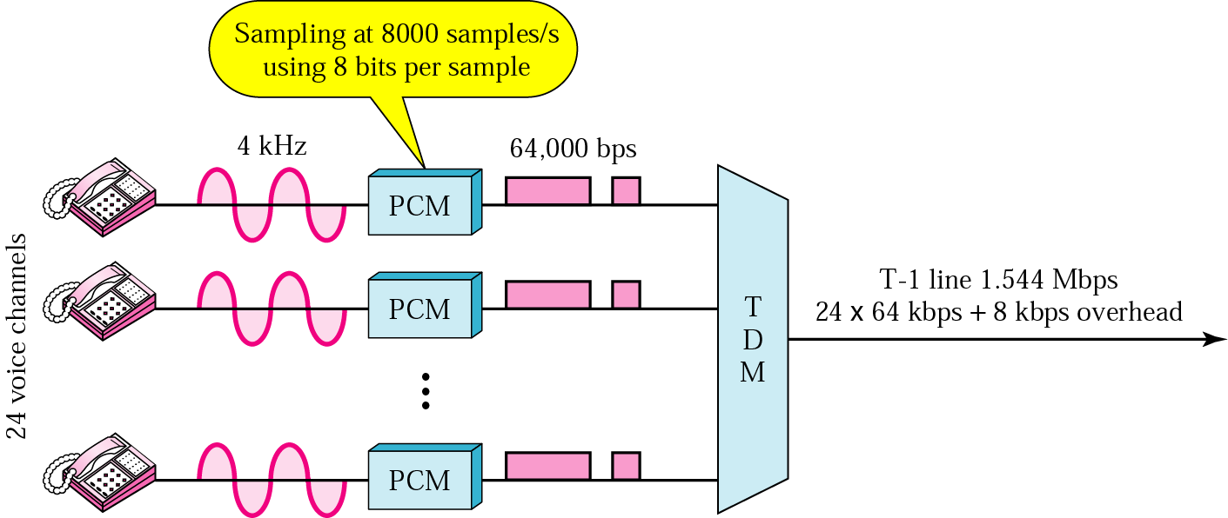
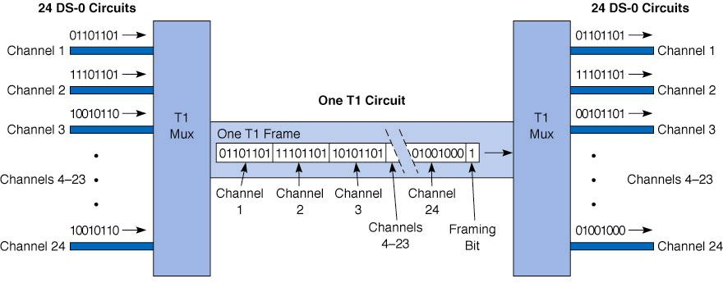
T-1 Copper Based line for multiplexing telephone lines
http://www.lageman.com/bandwidth.htm

Slide 31
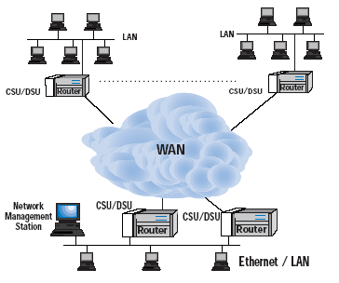
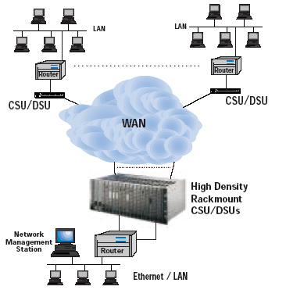
Typical WAN Configuration with T1
Standalone CSU/DSUs
Integrated CSU/DSUs
Introduction
1-<number>

Slide 32
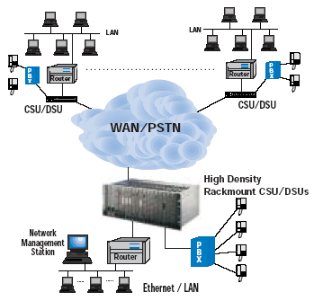
PBX and Router Sharing Single
T1 Access with “Drop-and-Insert” CSU/DSU
Introduction
1-<number>

Slide 33
Chapter 1: roadmap
  What is the Internet?
  Network edge
  Network core
  Network access and physical media
  Internet structure and ISPs
  Protocol layers, service models
Introduction
1-<number>

Slide 34
Internet ISP structure
roughly hierarchical
at center: “tier-1” ISPs (e.g., UUNet, BBN/Genuity, Sprint, AT&T), national/international coverage
  treat each other as equals
Tier-1 providers also interconnect at public network access points (NAPs)
Tier-1 providers interconnect (peer) privately
Tier 1 ISP
NAP
Tier 1 ISP
Tier 1 ISP
236 Internet Exchange Points (IXP) in 175 different areas.
http://www.datacentermap.com/ixps.html
Introduction
1-<number>

Slide 35
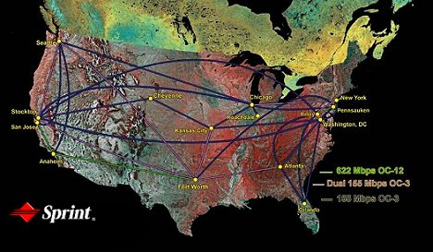
Tier-1 ISP: e.g., Sprint
Sprint US backbone network
Introduction
1-<number>

Slide 36
Internet ISP structure
“Tier-2” ISPs: smaller (often regional) ISPs
  Connect to one or more tier-1 ISPs, possibly other tier-2 ISPs
Tier-2 ISPs also peer privately with each other, interconnect at NAP
Tier-2 ISP pays tier-1 ISP for connectivity to rest of Internet.
tier-2 ISP is customer of
tier-1 provider
Tier-2 ISP
Tier-2 ISP
Tier 1 ISP
NAP
Tier 1 ISP
Tier 1 ISP
Tier-2 ISP
Tier-2 ISP
Tier-2 ISP
Introduction
1-<number>

Slide 37
Internet ISP structure
“Tier-3” ISPs/local ISPs
  last hop (“access”) network (closest to end systems)
local
ISP
local
ISP
local
ISP
local
ISP
local
ISP
Local and tier- 3 ISPs are customers of
higher tier ISPs
connecting them to rest of Internet
Tier-2 ISP
Tier-2 ISP
Tier 1 ISP
NAP
Tier 1 ISP
Tier 1 ISP
Tier-2 ISP
Tier-2 ISP
Tier-2 ISP
local
ISP
local
ISP
local
ISP
local
ISP
Introduction
1-<number>

Slide 38
Internet ISP structure
a packet passes through many networks!
local
ISP
Tier 3
ISP
local
ISP
local
ISP
local
ISP
Tier-2 ISP
Tier-2 ISP
Tier 1 ISP
NAP
Tier 1 ISP
Tier 1 ISP
Tier-2 ISP
Tier-2 ISP
Tier-2 ISP
local
ISP
local
ISP
local
ISP
local
ISP
Introduction
1-<number>

Slide 39
Chapter 1: roadmap
  What is the Internet?
  Network edge
  Network core
  Network access and physical media
  Internet structure and ISPs
  Protocol layers, service models
Introduction
1-<number>

Slide 40
Protocol “Layers”
Networks are complex!
many “pieces”:
  hosts
  routers
  links of various media
  applications
  protocols
  hardware, software
Question:
Is there any hope of organizing structure of network?
Or at least our discussion of networks?
Introduction
1-<number>

Slide 41
Organization of air travel
ticket (purchase)
baggage (check)
gates (load)
runway takeoff
airplane routing
ticket (complain)
baggage (claim)
gates (unload)
runway landing
airplane routing
airplane routing
a series of steps
Introduction
1-<number>

Slide 42

Layering of airline functionality
ticket (purchase)
baggage (check)
gates (load)
runway (takeoff)
airplane routing
ticket (complain)
baggage (claim
gates (unload)
runway (land)
airplane routing
ticket
baggage
gate
takeoff/landing
airplane routing
airplane routing
airplane routing
departure
airport
intermediate air-traffic
control centers
arrival
airport
Layers: each layer implements a service
  via its own internal-layer actions
  relying on services provided by layer below
Introduction
1-<number>

Slide 43
Internet protocol stack
application: supporting network applications
  FTP, SMTP, STTP
transport: host-host data transfer
  TCP, UDP
network: routing of datagrams from source to destination
  IP, routing protocols
link: data transfer between neighboring network elements
  PPP, Ethernet
physical: bits “on the wire”
application
transport
network
link
physical
Introduction
1-<number>

Slide 44
Encapsulation
source
message
M
application
transport
network
link
physical
segment
IP-1
H_{t}
M
datagram
H_{n}
H_{t}
M
frame
H_{l}
H_{n}
H_{t}
M
MAC-1
H_{l}
H_{n}
H_{t}
M
link
physical
H_{l}
H_{n}
H_{t}
M
P0
P1
switch
destination
H_{n}
H_{t}
M
network
link
physical
H_{n}
H_{t}
M
M
application
transport
network
link
physical
H_{ln}
H_{n}
H_{t}
M
H_{l}
H_{n}
H_{t}
M
IP-2
P0
H_{t}
M
H_{n}
H_{t}
M
P1
H_{ln}
H_{n}
H_{t}
M
router
MAC-2
Introduction
1-<number>

Slide 45
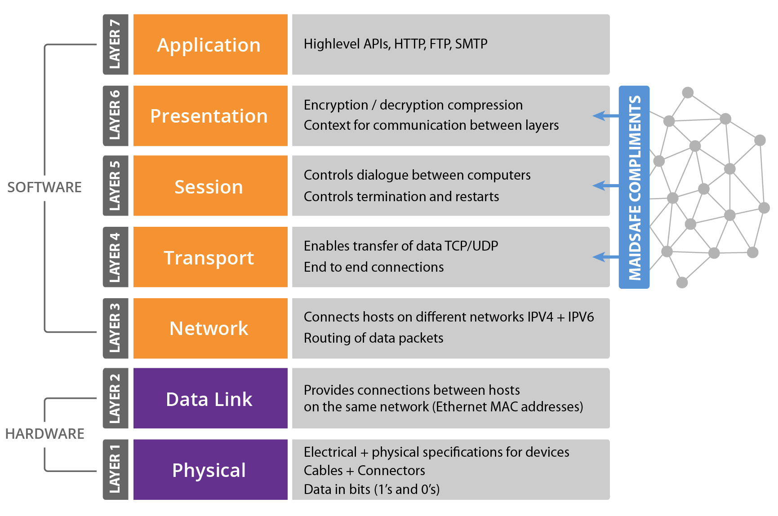
OSI model-
(Open System Interconnection)
Introduction
1-<number>

Slide 46
Data Encryption Road Map
Application
FTP, HTTP, BGP
Application
FTP, HTTP, BGP
Application
FTP, HTTP, BGP
Application
FTP, HTTP, BGP
Application
FTP, HTTP, BGP
SSL
TCP
TCP
SSL
TCP
TCP
IP
IP
TCP
IP
IP
IPSec
Ethr
IP
Ethr
Ethr
Ethr
WEP/WPA/WPA2
IPSec
IPSec
normal
application
application
with SSL
application
with IPSec
application
With WEP/WPA /WPA2
Ethr
WEP/WPA/WPA2
WEP/WPA/WPA2
application
with SSL, IPSec and WEP/WPA/WPA2

Slide 47
Network Security
The field of network security is about:
  how bad guys can attack computer networks
  how we can defend networks against attacks
  how to design architectures that are immune to attacks
Internet not originally designed with (much) security in mind
  original vision: “a group of mutually trusting users attached to a transparent network” ☺
  Internet protocol designers playing “catch-up”
  Security considerations in all layers!
Introduction
1-<number>

Slide 48
Bad guys can put malware into hosts via Internet
Malware can get in host from a virus, worm, or trojan horse.
Spyware malware can record keystrokes, web sites visited, upload info to collection site.
Infected host can be enrolled in a botnet, used for spam and DDoS attacks.
Introduction
1-<number>

Slide 49

Bad guys can attack servers and network infrastructure
Denial of service (DoS): attackers make resources (server, bandwidth) unavailable to legitimate traffic by overwhelming resource with bogus traffic
select target
break into hosts around the network (see botnet)
send packets toward target from compromised hosts
target
Introduction
1-<number>

Slide 50
The bad guys can sniff packets
Packet sniffing:
  broadcast media (shared Ethernet, wireless)
  promiscuous network interface reads/records all packets (e.g., including passwords!) passing by
A
C
src:B dest:A payload
B
  Wireshark software used for end-of-chapter labs is a (free) packet-sniffer
Introduction
1-<number>

Slide 51

The bad guys can record and playback
record-and-playback: sniff sensitive info (e.g., password), and use later
  password holder is that user from system point of view
C
A
src:B dest:A user: B; password: foo
B
Introduction
1-<number>

Slide 52
Introduction: Summary
Covered a “ton” of material!
Internet overview
what’s a protocol?
network edge, core, access network
  packet-switching versus circuit-switching
Internet/ISP structure
performance: loss, delay
layering and service models
You now have:
context, overview, “feel” of networking
more depth, detail to follow!
Introduction
1-<number>

